Slide 1
SAP Process Integration PI 7.1
Integration Configuration Object (ICO)
Notes:
The Advanced Adapter Engine (AAE) is used to connect the Integration Engine to
SAP systems or non-SAP systems. Using the various adapters in the Adapter Engine,
XML and HTTP-based messages (PI-SOAP format) can be converted to the specific
protocols and formats required by these systems, and the other way around. The AAE
is a further development of the Adapter Engine, known from earlier releases.
As of SAP NW Process Integration 7.1, you can now use integrated processing on the
AAE. In integrated processing, an external format is converted into a PI-SOAP format,
or the PI-SOAP format into an external format, on the AAE (“classic” processing),
and also, routing and mapping activities are performed by the AAE. In other words,
the functions of the AAE have been expanded to include routing and mapping.

Slide 2
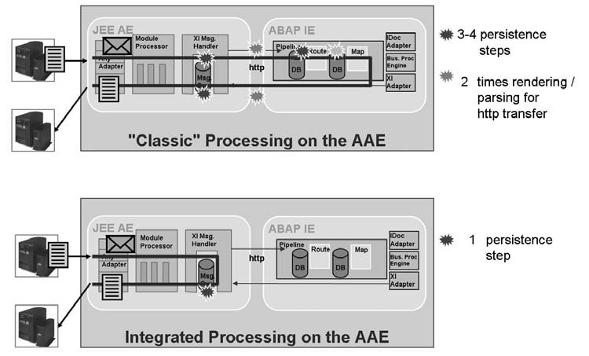
Advance Adapter Engine in PI 7.1
Notes:
In “classic” processing, the AAE converts the incoming message into the PI-SOAP
format. The message is then made persistent (that is, it is saved in the database) and
sent to the Integration Engine by HTTP. The next step is routing and mapping the
message, which involves writing the message to the database at least once. Then the
message is sent again by HTTP to the AAE, where a corresponding adapter converts
into the protocol the receiver is expecting and sends it to the receiver. During this
process on the AAE, the message is also stored again in the database.
Unlike “classic” processing, routing and mapping activities are carried out on the AAE
in integration processing, which, in this case, does not involve using the Integration
Engine in the message transfer. During this process, the message also only needs to
be saved to the database once. The following section will explain in more detail the
advantages of integrated processing and the current limitations to using integrated
processing.

Slide 3
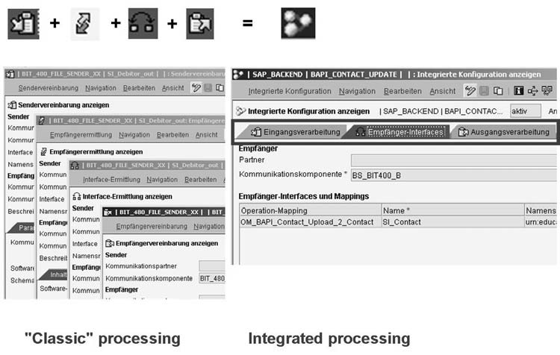
Configuration objects for “classic” and integrated processing on the AAE
Notes:
During “classic” processing, you must create at least three configuration objects in
the Integration Directory. These are receiver determination, interface determination,
and receiver agreement. In some scenarios, you are also required to create a sender
agreement. In contrast, you need to create only one object for integrated processing:
Integrated configuration. This object allows you to perform all required tasks,
such as those involving receiver system, receiver interface, mapping, and receiver
communication channel (and, if necessary, sender communication channel). By
creating this object, you are also determining that integrated processing should be
selected for this scenario.

Slide 4
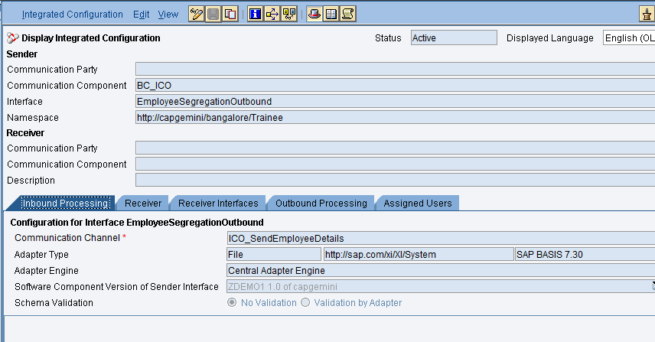
PI 7.1 ICO

Slide 5
Advantages
Increase in performance during the transmission of individual messages by not involving the Integration Engine
Reduction of resource consumption (memory space) through:
- Smaller number of persistence steps
- Smaller number of work processes on the Integration Engine of the Integration Server
Increased throughput of messages for each unit of time
Increased flexibility as certain scenarios can be completely transferred to a decentral AAE (when using firewalls, for example)

Slide 6
Limitations
• The sender and receiver adapters must run on the same AAE.
• Adapters that run on the Integration Engine (ABAP) cannot be used (this
Includes IDoc, HTTP and XI adapters).
Only simple routing is possible (no payload-based routing or message split).
ABAP-based mapping is not possible.

Slide 7
Value Mapping
Fix Values and Value Mapping
In the FixValues function (Conversions -> FixValues), key-value pairs are maintained within the Integration Repository. Simply, double-click to define the key-value pairs to map source keys to target values as shown.
In the Value Mapping function (Conversions -> Value mapping), you can maintain multiple key value pairs externally e.g. you could maintain them in the Integration Directory. These are picked up at the runtime.

Slide 8

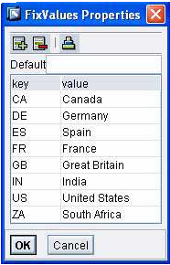
Example

Slide 9
ICO Demo
Demo

